Slide 1


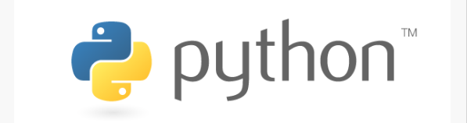
PYTHON Programming
By: Surendrakc

Slide 2
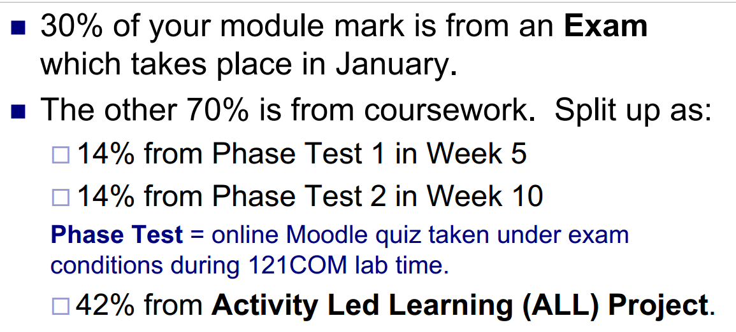

Slide 3
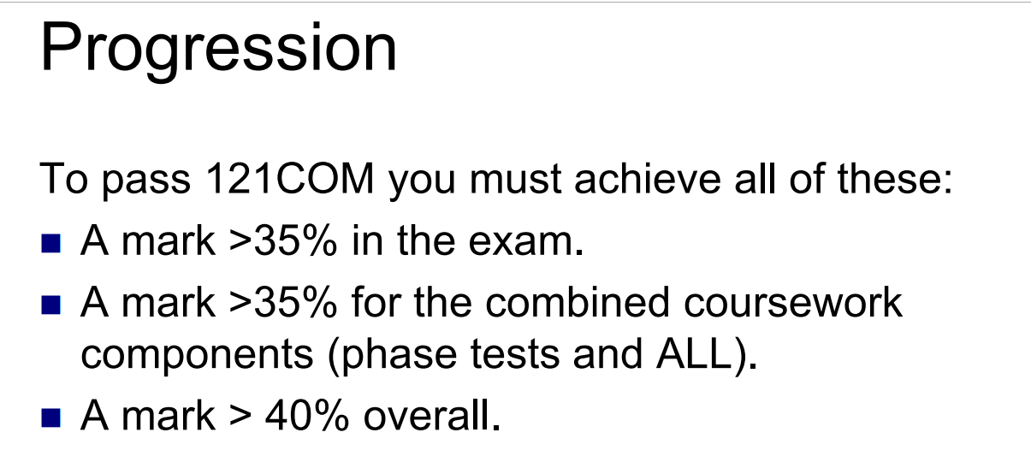

Slide 4
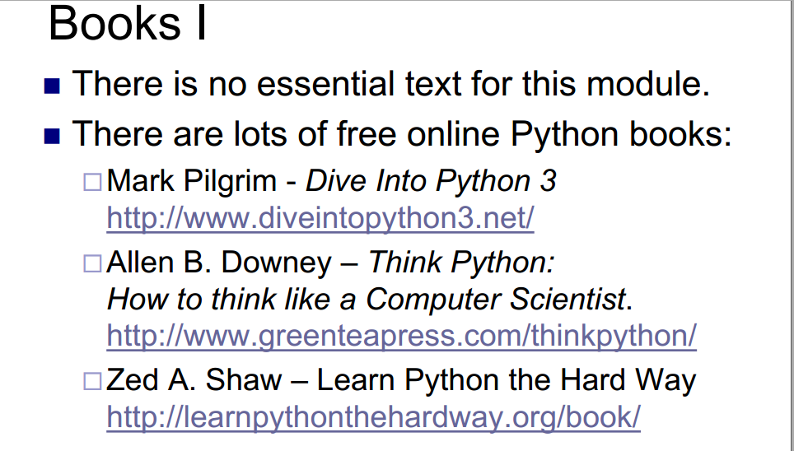
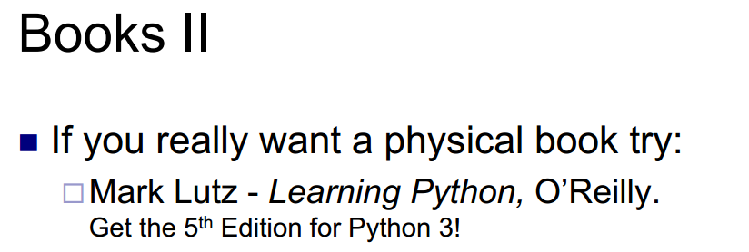

Slide 5
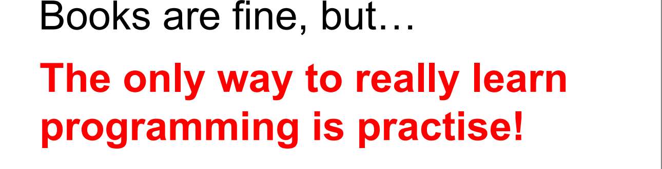


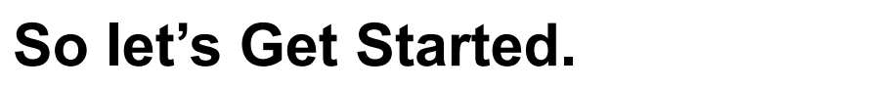

Slide 6
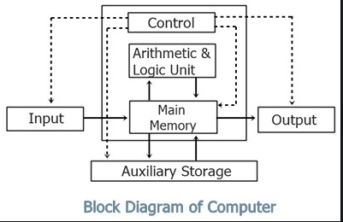

LOYAL IDIOT?

Slide 7
What is computer programming?
WRITING EXECUTABLE COMPUTER PROGRAM FOR ACCOMPLISHING A SPECIFIC COMPUTING TASK.
programming is to find a sequence of instructions that will automate the performance of a task
way of giving computers instructions about what they should do next
These instructions are known as code, and computer programmers write code to solve problems or perform a task.
he main purpose of programming is to have a machine do a task for us. (Hopefully programming the machine to do this is less effort in the long run)
Programming is writing instructions for a incredibly loyal idiot

Slide 8
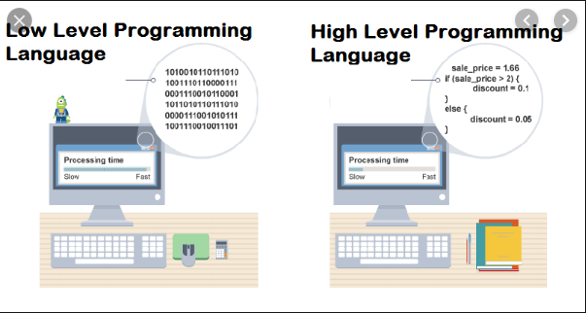
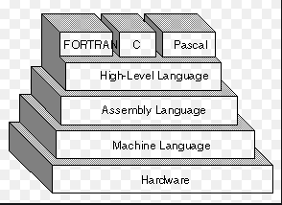
Programming languages

Slide 9
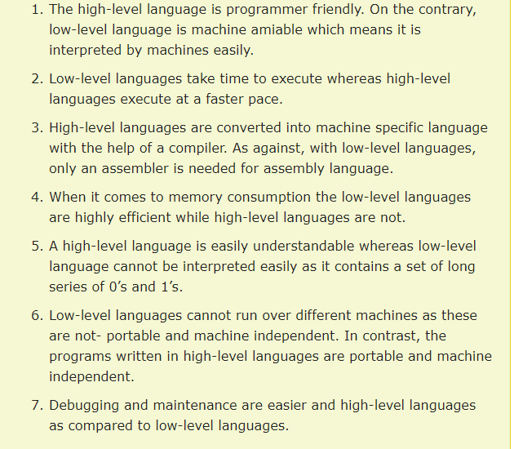
Programming languages

Slide 10
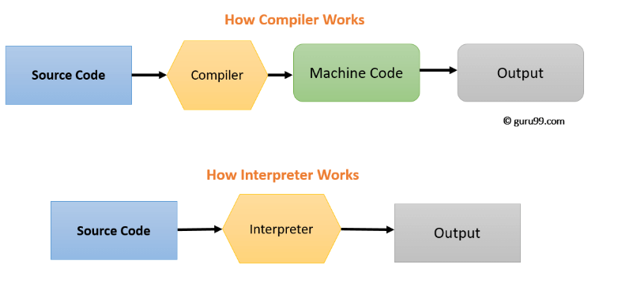
A computer program that transforms source code written in a high-level programming language into a lower level language (COMPILER,interpreter)

Slide 11
Compiler vs Interpreter
COMPILER | INTERPRETER
Compile will parse or analyses all of the language statements for its correctness. If incorrect, throws an error If no error, the compiler will convert source code to machine code. | Source statements executed line by line DURING Execution
Generates intermediate object code which further requires linking, hence requires more memory | No intermediate object code is generated, hence are memory efficient.
It generates the error message only after scanning the whole program. Hence debugging is comparatively hard. | Continues translating the program until the first error is met, in which case it stops. Hence debugging is easy
The compilation is done before execution. | Compilation and execution take place simultaneously.
Display all errors after compilation, all at the same time. Debugging harder | Displays error of each line one by one. Debugging easier
Compile once and run anytime. Faster | Line by line interpreted every time they run. Slow
Programming language like C, C++ use compilers. | Programming language like Python, Ruby use interpreters.

Slide 12
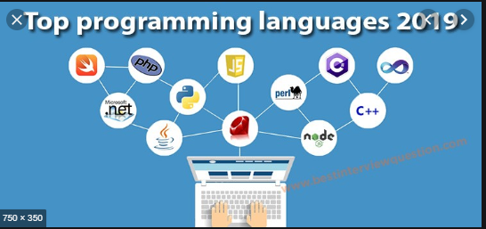
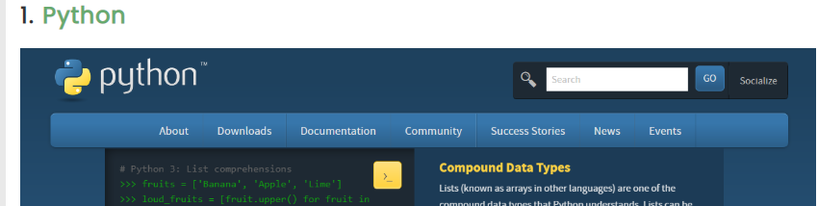
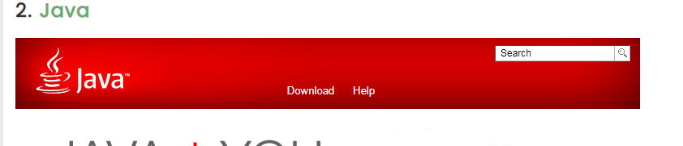
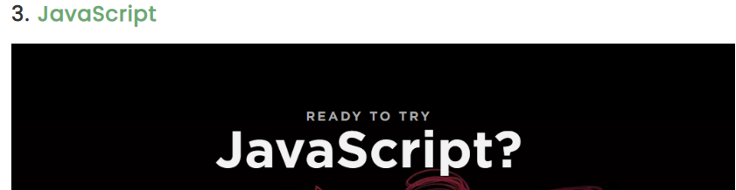
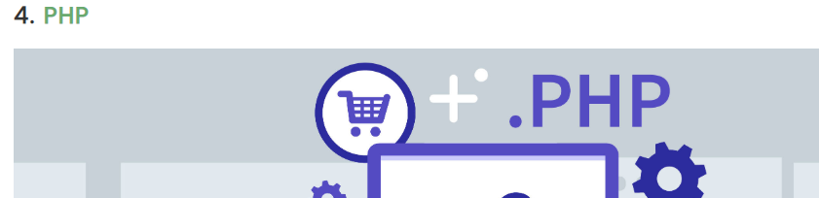
PYTHON Tops the list: GitHub

Slide 13
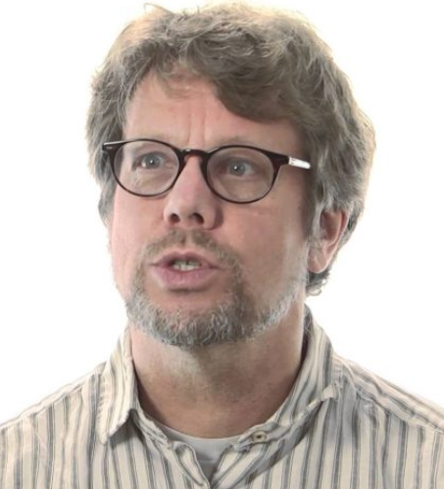

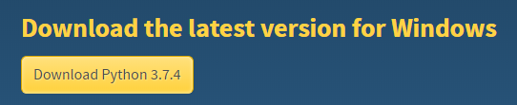
Python
Fun fact. Python is not named after the snake. It’s named after the British TV show Monty Python’s Fly Circus
Python was introduced by Guido Van Rossum in 1989
ABC Programming influenced the design and development of python.

Slide 14
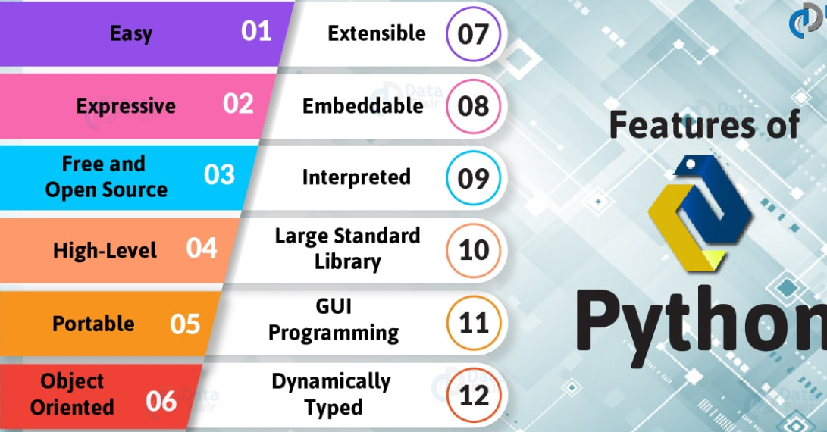
PYTHON FEATURES

Slide 15
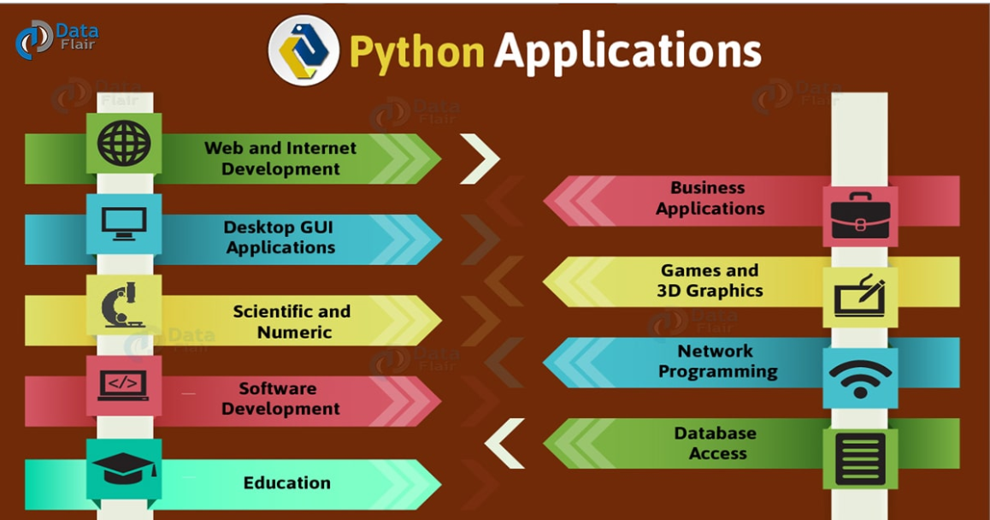

Slide 16
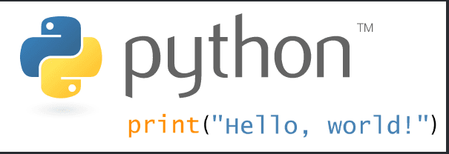

Slide 17
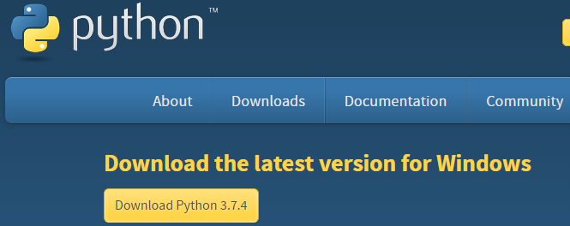
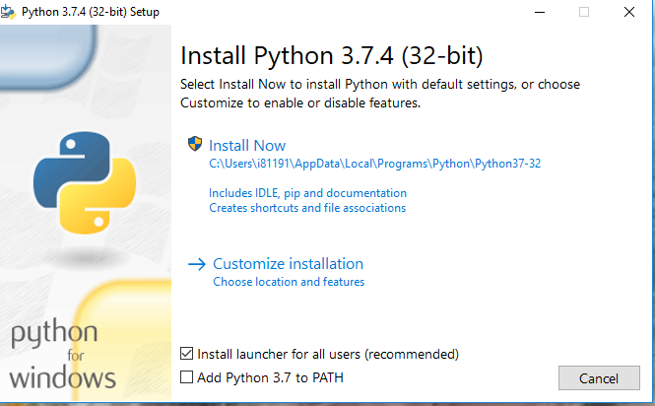
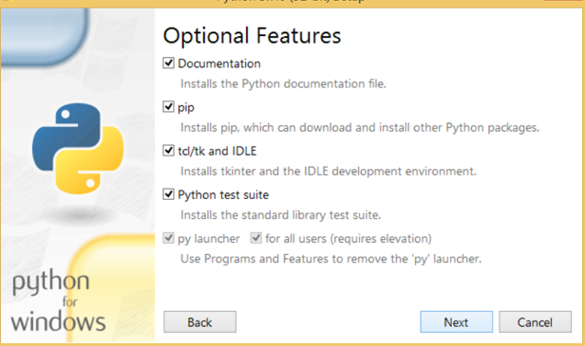
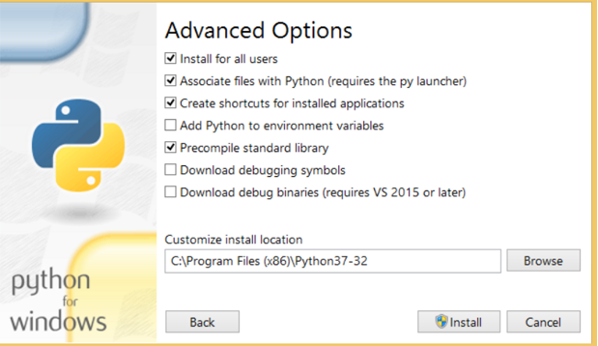
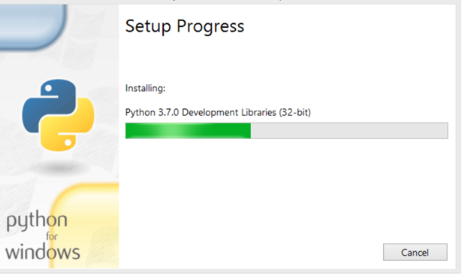
How to Install Python (Environment Set-up)
https://www.python.org/downloads/
Visit the link https://www.python.org/downloads/ to download the latest release of Python

Slide 18
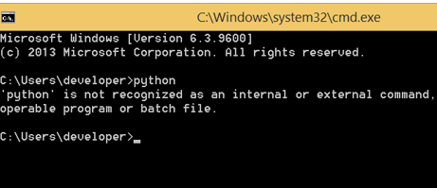
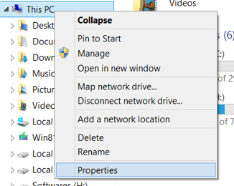
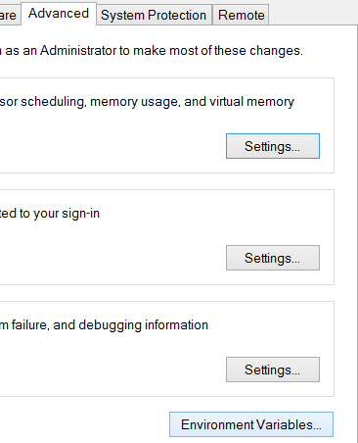
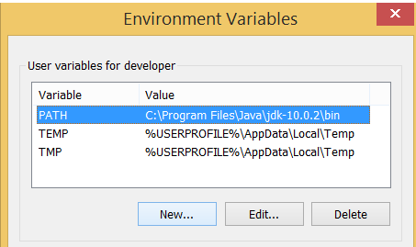
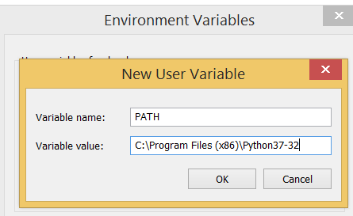
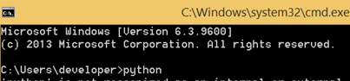

Slide 19
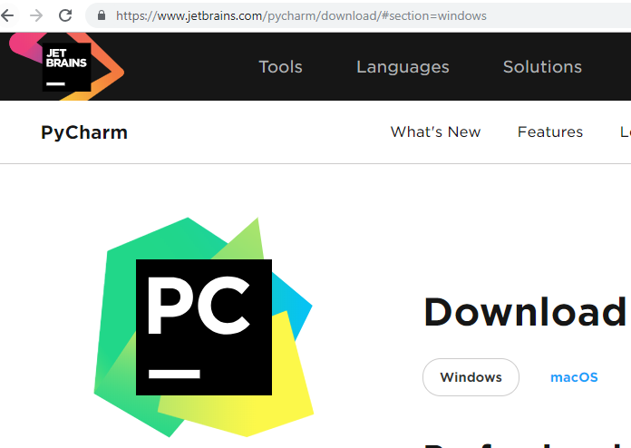
IDE
Save and reload code files
Debugging support
Syntax highlighting
Automatic code formatting
MANY MORE…

Slide 20
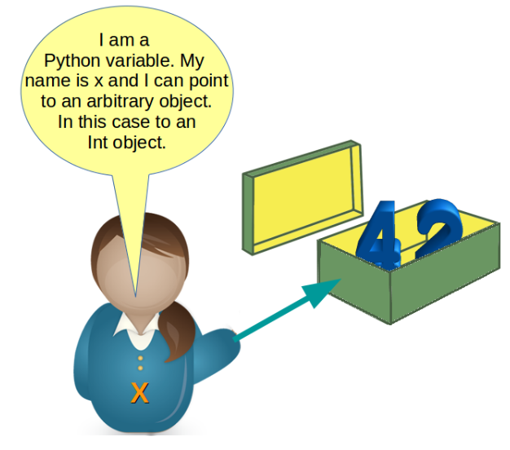
PYTHON VARIABLE
A VARIABLE IS SOMETHING THAT CAN CHANGE.
A variable is a way of referring to a memory location used by a computer program
A VARIABLE IS THE NAME GIVEN TO THE PORTION OF MEMORY LOCATION WHERE DIFFERENT KINDS OF DATA ARE STORED. While the program is running, variables are accessed and sometimes changed, i.e., a new value will be assigned to a variable.

Slide 21
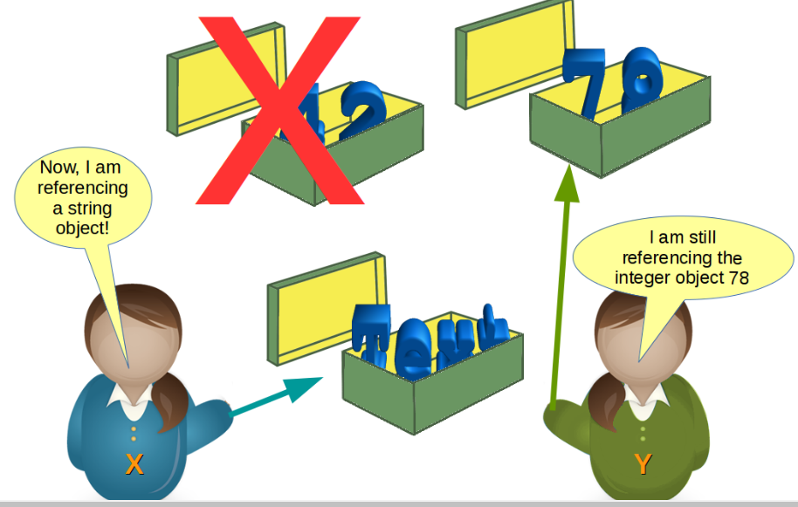
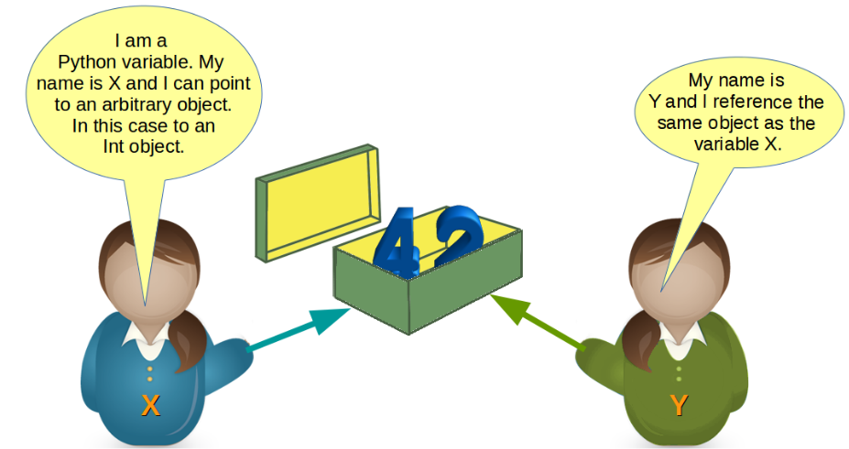
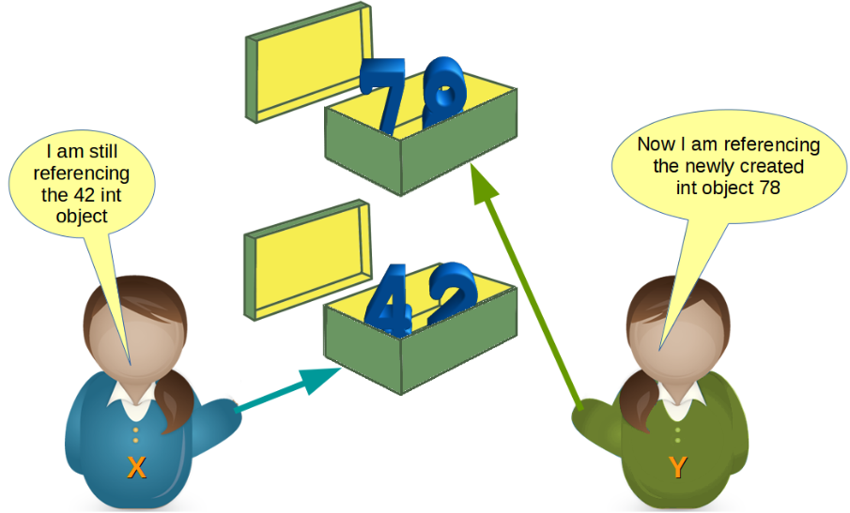

Slide 22
VARIABLE NAMING CONVENTION
The first character of the variable must be an alphabet or underscore ( _ )
All the characters except the first character may be an alphabet of lower-case(a-z), upper-case (A-Z), underscore or digit (0-9)
Identifier name must not contain any white-space, or special character (!, @, #, %, ^, &, *)
Identifier name must not be similar to any keyword defined in the language
Identifier names are case sensitive for example my name, and MyName is not the same
Examples of valid identifiers : a123, _n, n_9, etc
Examples of invalid identifiers: 1a, n%4, n 9, etc. Multiple variable assignments is also possible.
Syntax: variable_name=value

Slide 23
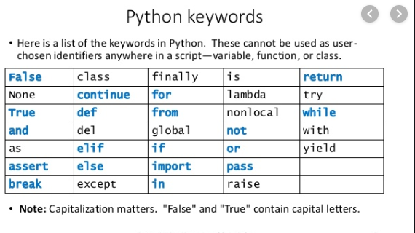
keywords
Keywords are the reserved words in Python
We cannot use a keyword as a variable name, function name or any other identifier
In Python, keywords are case sensitive
There are 33 keywords in Python 3.7
They have pre-defined meanings and these keywords have to be used to develop programming instructions

Slide 24
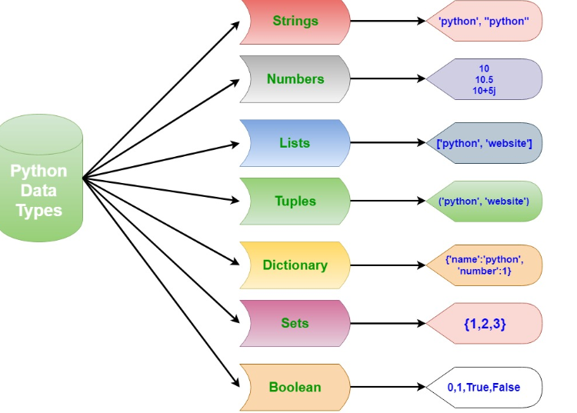
datatypes
Refers to the information stored in a variable
Python data types are dynamic, because we don’t need to mention type of the variable

Slide 25
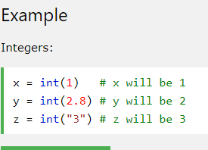
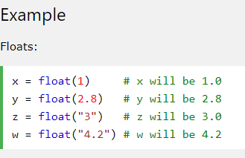
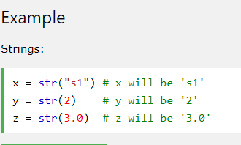
Type conversion (casting)
Conversion of one data type to another type
INT(): CONVERTS AN INTEGER NUMBER FROM AN INTEGER LITERAL, A FLOAT LITERAL (BY ROUNDING TO THE PREVIOUS WHOLE NUMBER), OR A STRING LITERAL (providing the string represents a whole number)
Float(): converts a float number from an integer literal, a float literal or a string literal (providing a string represents a float or an integer)
Str(): converts a string from a wide variety of data types including strings, integer and float literals

Slide 26
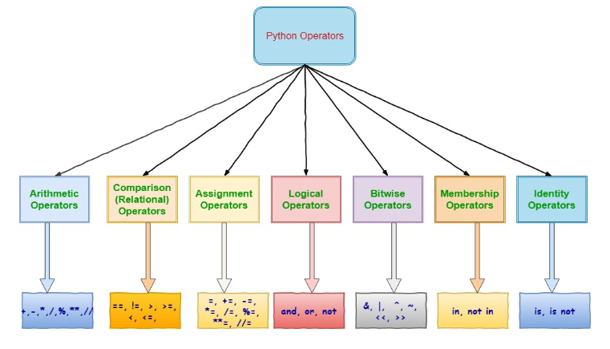
OPERATORS

Slide 27
Literal
Input from the user
comments

Slide 28
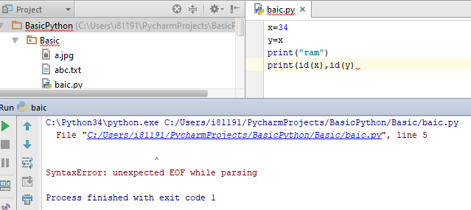
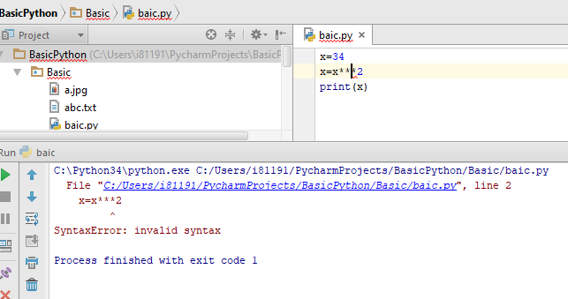
Error-Syntax error
Also known as compile time error
Mistakes that are against the rules of the language
Example: In Python, every closing parenthesis should be matched with a preceding opening parenthesis. So the next command has a syntax error. (75-12)/4)
Easy to find out: IDEs highlight the mistakes when you write code
You receive an error message when you try to run
For an interpreted language (like Python) the code is not executed if syntactically incorrect

Slide 29
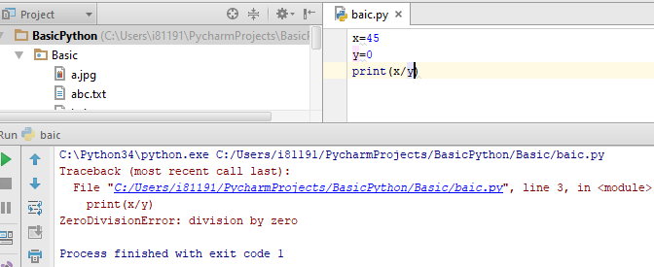
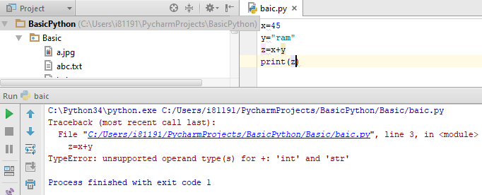
Error-runtime error
Also known as compile time error
Code is syntactically correct, however, results in the performance of illegal operation.
Example: In Python, dividing by zero is illegal. Hence the next command is syntactically correct, but causes a runtime error >>> (75-12)/(4-2*2)
Example: In Python, we cannot add objects of different types. >>> Birthday = 29 + "February " + 1991
Will be identified, but not until code is running. With large code this could result in long delay Runtime errors are called exceptions: because they usually mean something exceptional has happened

Slide 30
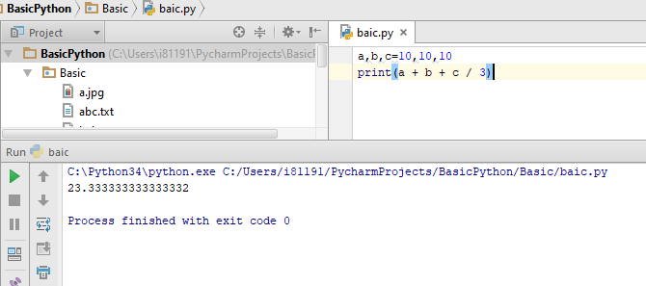
Error-logical error
This is when code is syntactically correct, and runs without errors, but is still incorrect.
Example: The following code aimed to find the average of 3 numerical values stored in the variables a,b,c. >>> a + b + c / 3 It fails because we forgot the brackets
Example: We saw earlier that the following code causes no error. >>> Birthday = str(29) + "February " + str(1991) However, 1991 was not a leap year so it cannot be correct
These are the most difficult errors to uncover as No error messages provided . Caused by computers doing what you told them to do instead of what you wanted them to do

Slide 31
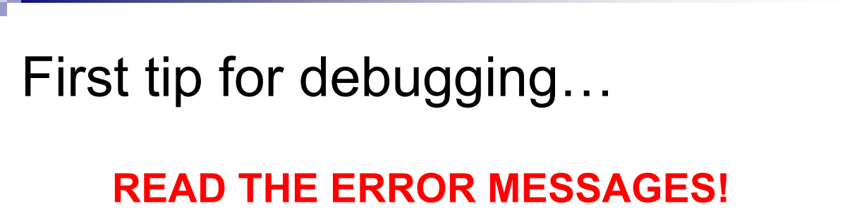
Debugging
Programming errors are commonly called bugs. Finding & correcting them is called debugging Bugs are common place in programming.
You cannot avoid them, you must deal with them
Debugging is one of the most important skills for a programmer.
Some even argue it is the most interesting / challenging part of programming
IT IS A KIND OF DETECTIVE WORK, YOU HAVE SOME/NO CLUE, AND YOU HAVE TO FIND THAT

Slide 32


dEBUGGING

Slide 33


debugging
F8

Slide 34
END OF WEEK 1
By: Surendrakc

Slide 35

BOOLEAN LOGIC AND LOGICAL OPERATOR
The logical operators are used primarily in the expression evaluation to make a decision. Python supports the following logical operators (and, or , not)

Slide 36
SHORT CIRCUIT OPERATTION
Python has a useful feature called short circuit operation that acts on logical operator and/or
Python stops computing further when they know the answer.
x = 7
y = 10
if x >6 or y < 20:
print('OK’)
HERE, AS SOON AS PYTHON DISCOVERS THAT X IS GREATER THAN 6, IT KNOWS AHT WHOLE OR STATEMENT IS TRUE, SO IT DOESN’T BOTHER CHECKING Y. IT DOESN’T MATTER WHETHER Y IS LESS THAN 20 OR NOT, IT WON’T AFFECT THE OUTCOME CECAUSE AN OR STATEMENT IS ALWAYS TRUE IF EITHER OF THE CONDITIONS IS TRUE.
Python guarantees not to evaluate the second term if the first term is true
x = 5
y = 10
if x > 6 and y < 20:
print('OK’)
X>6 IS FALSE. SO PYTHON NEVER EVALUATES Y<20 BECAUSE IT ALREADY KNOWS THE FINAL RESULT WILL BE FALSE.
SO OR STATEMENT STOPS AS SOON AS IF ENCOUNTERS THE FIRST TRUE CASE
AN AND STATEMENT STOPS AS SSON AS IF ENCOUNTERS THE FIRST FALSE CASE.

Slide 37



Short circuiting to avoid error

Slide 38

Decision making STATEMENTS
So far, everything was sequential execution.
When we consider our real-time scenario every day, we make some decisions and based on the decisions made we will take further actions
Conditional statements gives us an ability to check conditions and change the behavior or the program accordingly.
Controls the program flow

Slide 39






If statement
IF STATEMENT IN PYTHON
INDENTION..very important

Slide 40




IF ELSE STATEMENT

Slide 41



ELIF STATEMENT (ELSE-IF LADDER)

Slide 42



NESTED IF STATEMENT

Slide 43


LIST- is a collection which is ordered and changeable. Allows duplicate members.

Slide 44


tuple- is a collection which is ordered and unchangeable. Allows duplicate members

Slide 45



set- is a collection which is unordered and unindexed. No duplicate members.

Slide 46


Dictionary is a collection which is unordered, changeable and indexed. No duplicate members

Slide 47

string

Slide 48
string
capitalize() | Converts the first character to upper case
center() | Returns a centered string
count() | Returns the number of times a specified value occurs in a string
endswith() | Returns true if the string ends with the specified value
find() | Searches the string for a specified value and returns the position of where it was found
index() | Searches the string for a specified value and returns the position of where it was found
replace() | Returns a string where a specified value is replaced with a specified value
strip() | Returns a trimmed version of the string

Slide 49

loops

Slide 50







For loop

Slide 51






While loop

Slide 52


Break/continue

Slide 53

Nested loop

Slide 54
function
A function can be defined as the organized block of reusable code which can be called whenever required.
Python allows us to divide a large program into the basic building blocks known as function
A function can be called multiple times to provide reusability and modularity to the python program.
A function can return data as a result.
The idea is to put some commonly or repeatedly done task together and make a function, so that instead of writing the same code again and again for different inputs, we can call the function.
Python provides built-in functions like print(), etc. but we can also create your own functions. These functions are called user-defined functions.
A function is a block of organized, reusable code that is used to perform a single, related action. Functions provide better modularity for your application and a high degree of code reusing.

Slide 55
function
Advantage of functions in python
There are the following advantages of C functions.
By using functions, we can avoid rewriting same logic/code again and again in a program.
We can call python functions any number of times in a program and from any place in a program.
We can track a large python program easily when it is divided into multiple functions.
Reusability is the main achievement of python functions.
However, Function calling is always overhead in a python program.

Slide 56
Function-advantages
User-defined functions help to decompose a large program into small segments which makes program easy to understand, maintain and debug.
Improving clarity of the code
If repeated code occurs in a program. Function can be used to include those codes and execute when needed by calling that function.
Programmers working on large project can divide the workload by making different functions
We can call python functions any number of times in a program and from any place in a program.

Slide 57






Slide 58



Default argument
A default argument is a parameter that assumes a default value if a value is not provided in the function call for that argument.

Slide 59

Function arguments

Slide 60


Required argument

Slide 61

Keyword argument

Slide 62

Variable length arguments
In the large projects, sometimes we may not know the number of arguments to be passed in advance.
In such cases, Python provides us the flexibility to provide the comma separated values which are internally treated as tuples at the function call
However, at the function definition, we have to define the variable with * (star) as *<variable - name >.

Slide 63
Scope of variable
All variables in a program may not be accessible at all sections in that program. This depends on where you have declared a variable.
The scope of a variable determines the portion of the program where you can access a particular identifier. There are two basic scopes of variables in Python −Global variables, Local variables.
Variables that are defined inside a function body have a local scope, and those defined outside have a global scope
This means that local variables can be accessed only inside the function in which they are declared, whereas global variables can be accessed throughout the program body by all functions

Slide 64


Scope of variable

Slide 65

Call by reference

Slide 66
docstrings
Python documentation strings (or docstrings) provide a convenient way of associating documentation with Python modules, functions, classes, and methods.
Unlike conventional source code comments, the docstring should describe what the function does, not how.
What should a docstring look like?
The doc string line should begin with a capital letter and end with a period.
The first line should be a short description.
If there are more lines in the documentation string, the second line should be blank, visually separating the summary from the rest of the description.
The following lines should be one or more paragraphs describing the object’s calling conventions, its side effects, etc

Slide 67
docstrings
Declaring Docstrings: The docstrings are declared using “””triple double quotes””” just below the class, method or function declaration. All functions should have a docstring.
Accessing Docstrings: The docstrings can be accessed using the __doc__ method of the object or using the help function. The below example demonstrates how to declare and access a docstring.
def power(a, b):
"""Returns arg1 raised to power arg2."""
return a**b
print power.__doc__

Slide 68
docstrings
def my_function(arg1):
"""
Summary line.
Extended description of function.
Parameters: arg1 (int): Description of arg1
Returns: int: Description of return value
"""
return arg1
print my_function.__doc__

Slide 69
rECURSION
Recursion is the process of defining something in terms of itself
A physical world example would be to place two parallel mirrors facing each other. Any object in between them would be reflected recursively.
Movie:inception
We know that in Python, a function can call other functions. It is even possible for the function to call itself. These type of construct are termed as recursive functions.
A recursive function generally has two components:
Base case (when recursive call should stop)
The call to itself

Slide 70
recursion
Advantages
Recursive functions make the code look clean and elegant
A complex task can be broken down into simpler sub-problems
Disadvantages
Sometimes logic behind recursion is hard to follow through
Recursive calls are expensive (inefficient) as they take up a lot of memory and time
Recursive functions are hard to debug

Slide 71

rECURSION

Slide 72

rECURSION

Slide 73

recursion

Slide 74
namespace
A namespace is a system to have a unique name for each and every object in Python and avoid conflict
An object might be a variable or a method.
Python itself maintains a namespace in the form of a Python dictionary (key value pair)
Real example: Files in directories
It maintains a name-to-object mapping where names act as keys and the objects as values
Multiple namespaces may have the same name but pointing to a different variable
Dir() function used to find namespace

Slide 75


namespace

